Slide 1

How DevOps and microservices impact your application architecture and development
Arun Gupta - Director, Developer Advocacy and Technical Marketing, Red Hat
Christina Wong - Principal Product Marketing Manager, Red Hat

Slide 2


Arun – avid marathoner, STEM to kids

Slide 3
Arun Gupta, helping solve problems
Director, JBoss Middleware
Technical Marketing
Developer Advocacy
Hot topics
JBoss Middlware
Microservices
DevOps
Containers
Developer Tooling

Slide 4


Christina Wong, crazy race car driver

Slide 5
Christina Wong, responsible product marketing manager
JBoss Middleware application runtimes and services
Red Hat JBoss Enterprise Application Platform
Red Hat JBoss Data Grid
Hot topics
Devops
Microservices
Application platforms
Fast data

Slide 6

What’s the problem?

Slide 7







Business back in the day...

Slide 8
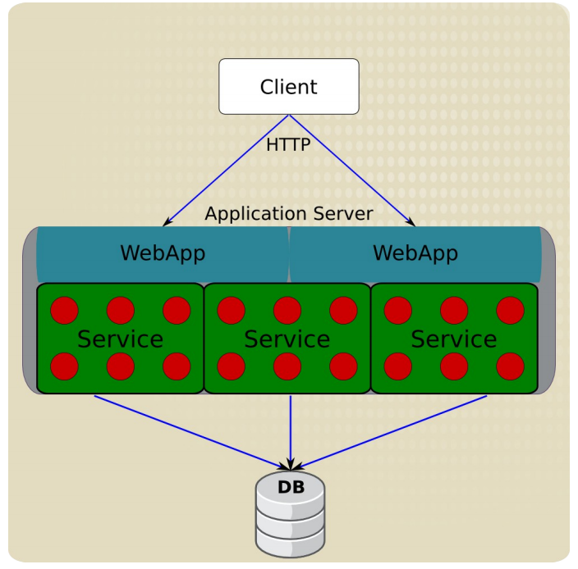
Monolithic architecture
Logically modular, deployed as monolith
Great for small apps, small teams
Simple systems
Dev, test, deploy
Optimized for efficiency and latency
Notes:
Simple to develop, test, and deploy
Small teams
Simple systems
Optimized for efficiency and latency

Slide 9
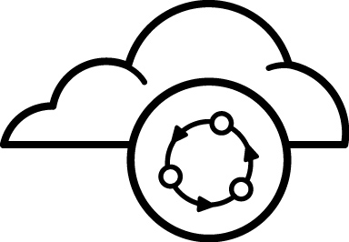
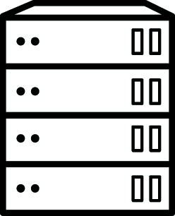

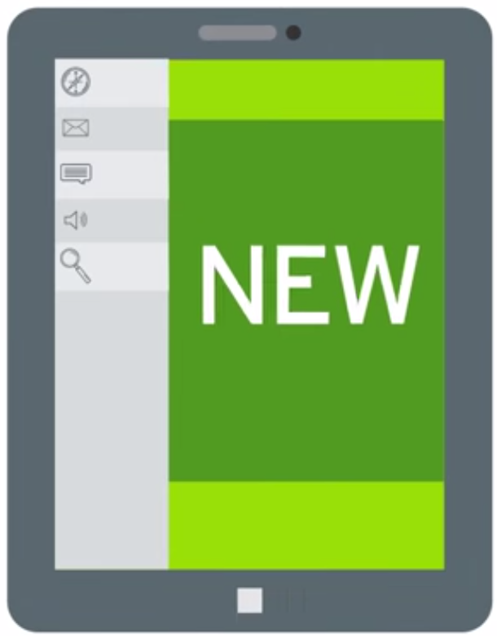


Business today...

Slide 10
What’s the problem?
More, more, more
Customers demand more
Business demands more
FAST!
But wait!!!
Enterprise stability, reliability
Predictable processes
Manage risk, technical debt
Large complex monolithic apps
Difficult maintenance
Unwieldy
Hard to test, trial new tech, fix
Stuck with the original app

Slide 11
The goal?
Meet the needs of modern business
interconnected
immediate
high variety of customer touch points
data from many sources
engaging
Personalized
Experiment, fail fast
Mobility

Slide 12
The solution
Scales out (on x or z axis?)
Fast to update, refresh
Hybrid cloud
Developers can innovate
Operations can manage, maintain
Easy to upgrade
Easy to isolate problems
Potentially polyglot
Enables cross team communication
…the “modern application”

Slide 13
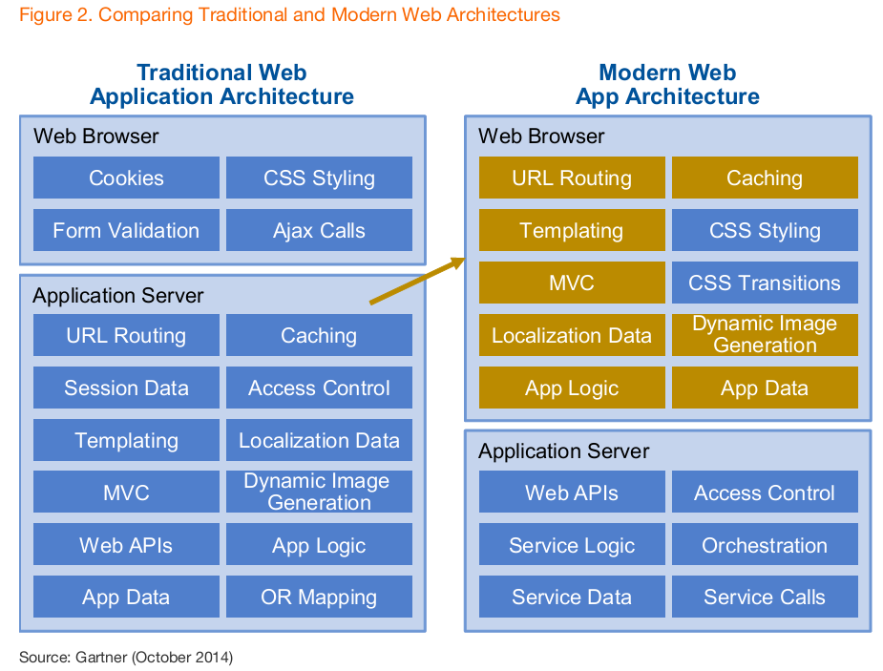
A new architecture for a modern business
Notes:
from gartner…
concept of application server is evolving
how to transition, what can we use that we have? do we need new stuff

Slide 14
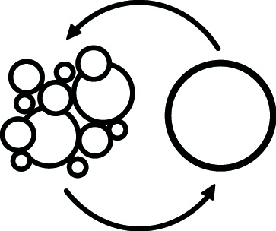
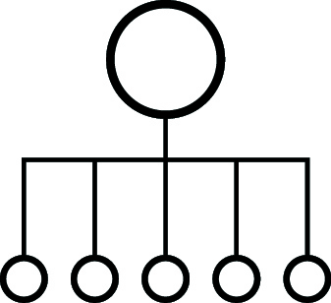



More than just new approaches to applications...
Processes
Architectures
Languages
Technologies
Platforms
Notes:
processes:
architectures: Microservices - Emphasizes decomposition of applications into single-purpose, loosely coupled services managed by cross-functional teams, for delivering and maintaining complex software systems with the velocity and quality required by today’s digital business
technologies: app server? containerless apps?
platforms: paas
languages: popularity of languages that support complex web apps: HTML5 - specifically to make it easy to consume, interact with morn web apps - on a variety of interfaces - desktops smartphones, tablets, etc…
Other trends….??

Slide 15

Processes

Slide 16
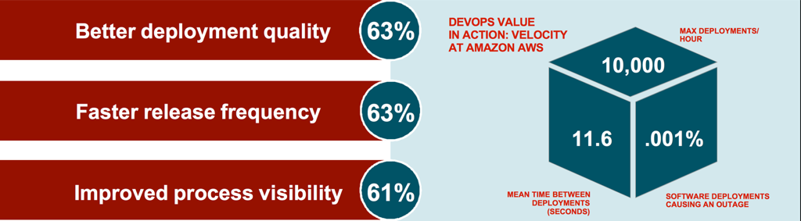

Slide 17
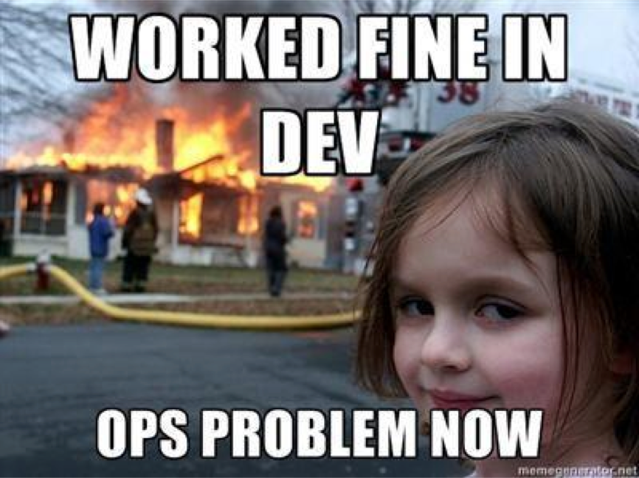

Slide 18
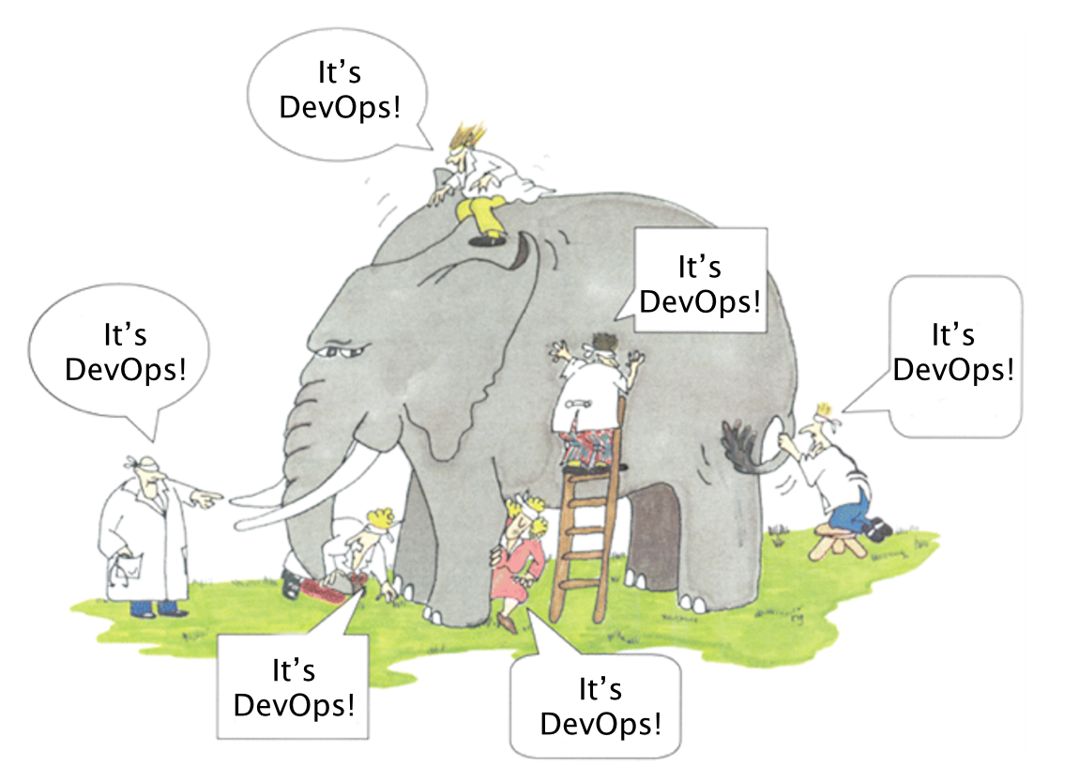

Slide 19
What is DevOps?
DevOps is an approach to process, culture, and tools for delivering increased business value and responsiveness through rapid, iterative, and high-quality IT service delivery.

Slide 20


Slide 21
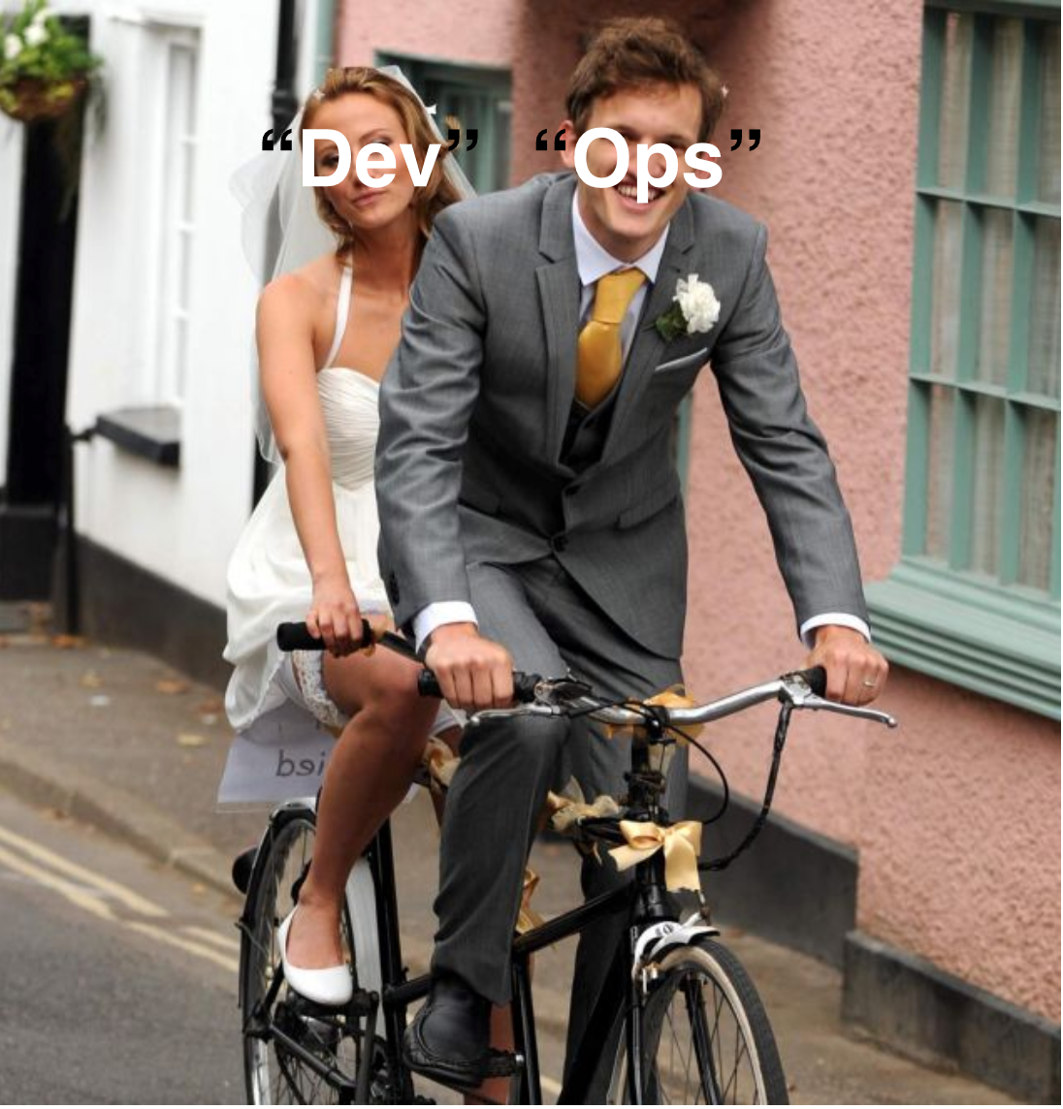

Slide 22
Five “C”s of DevOps
Collaboration between “dev” and “ops”
Culture
Code everything - application and configuration
Consistency - automation over documentation
Continuous delivery

Slide 23
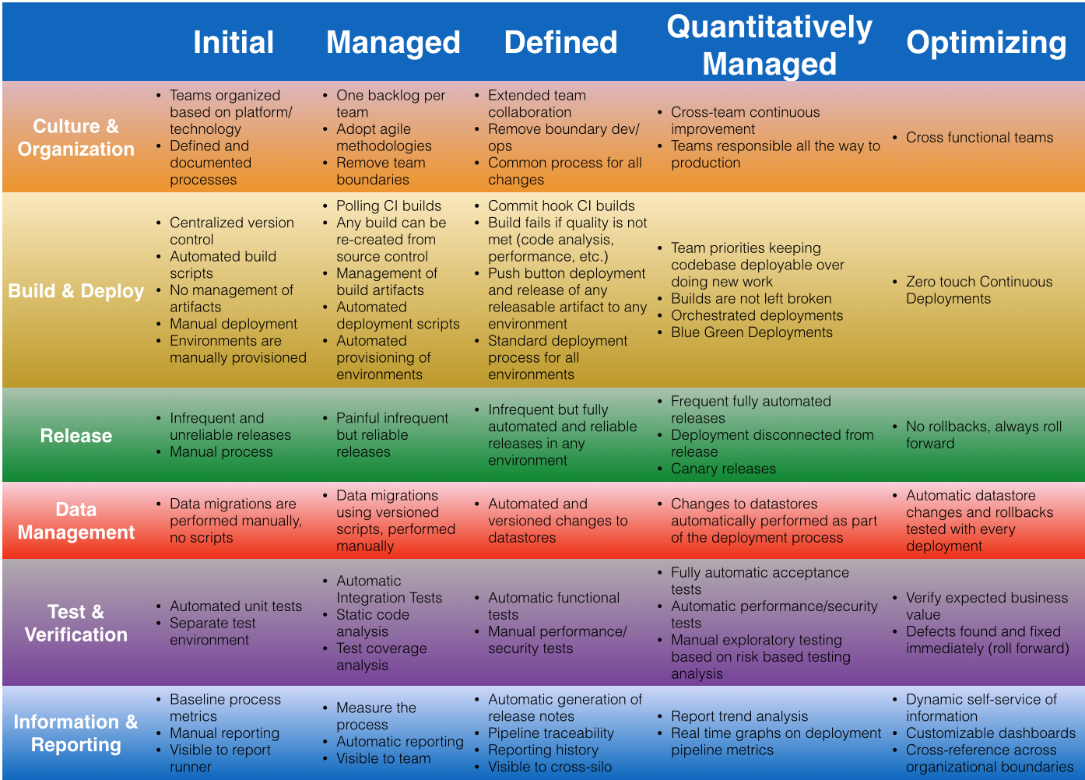
http://blog.arungupta.me/continuous-integration-delivery-deployment-maturity-model/

Slide 24

Architectures

Slide 25
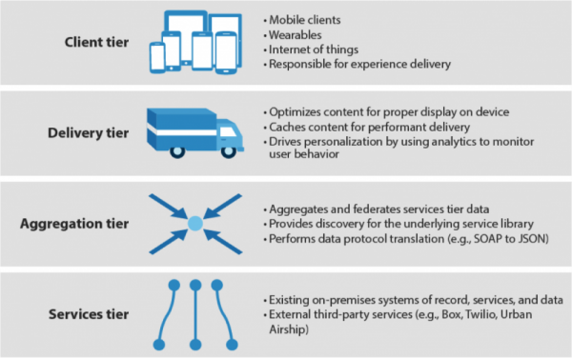
http://blogs.forrester.com/ted_schadler/13-11-20-mobile_needs_a_four_tier_engagement_platform

Slide 26

“America is all about speed. Hot, nasty badass speed.”

Slide 27
An architectural approach, that emphasizes the decomposition of applications into single-purpose, loosely coupled services managed by cross-functional teams, for delivering and maintaining complex software systems with the velocity and quality required by today’s digital business

Slide 28
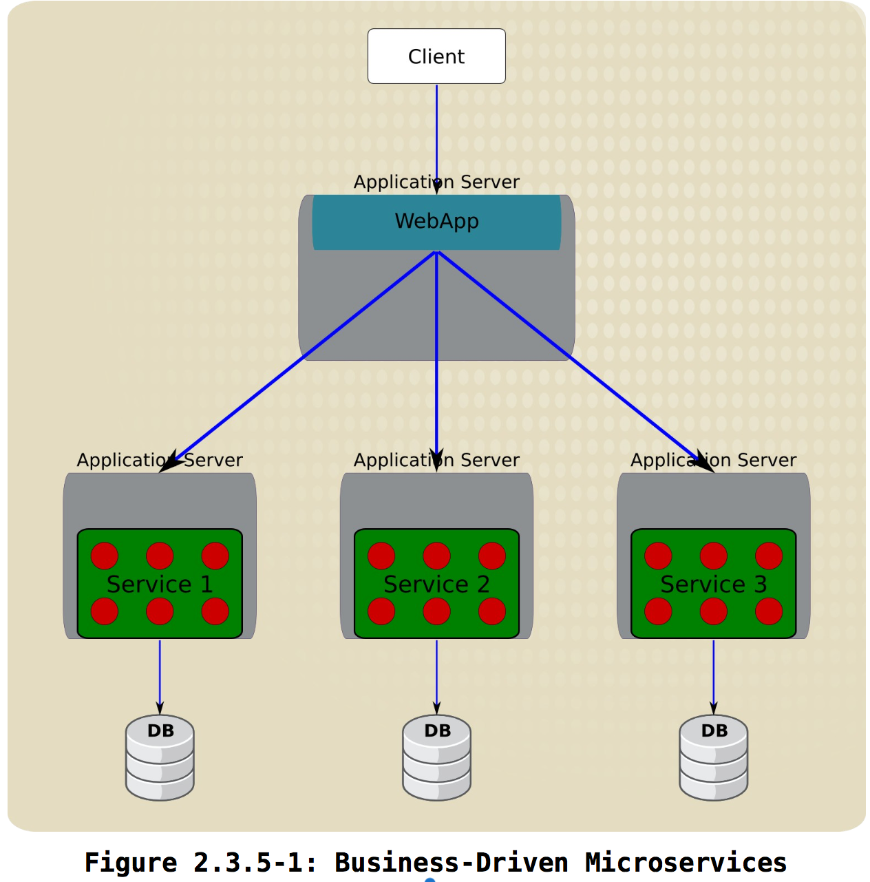
Business-driven microservices

Slide 29
Platforms
Technologies and tools
Languages

Slide 30
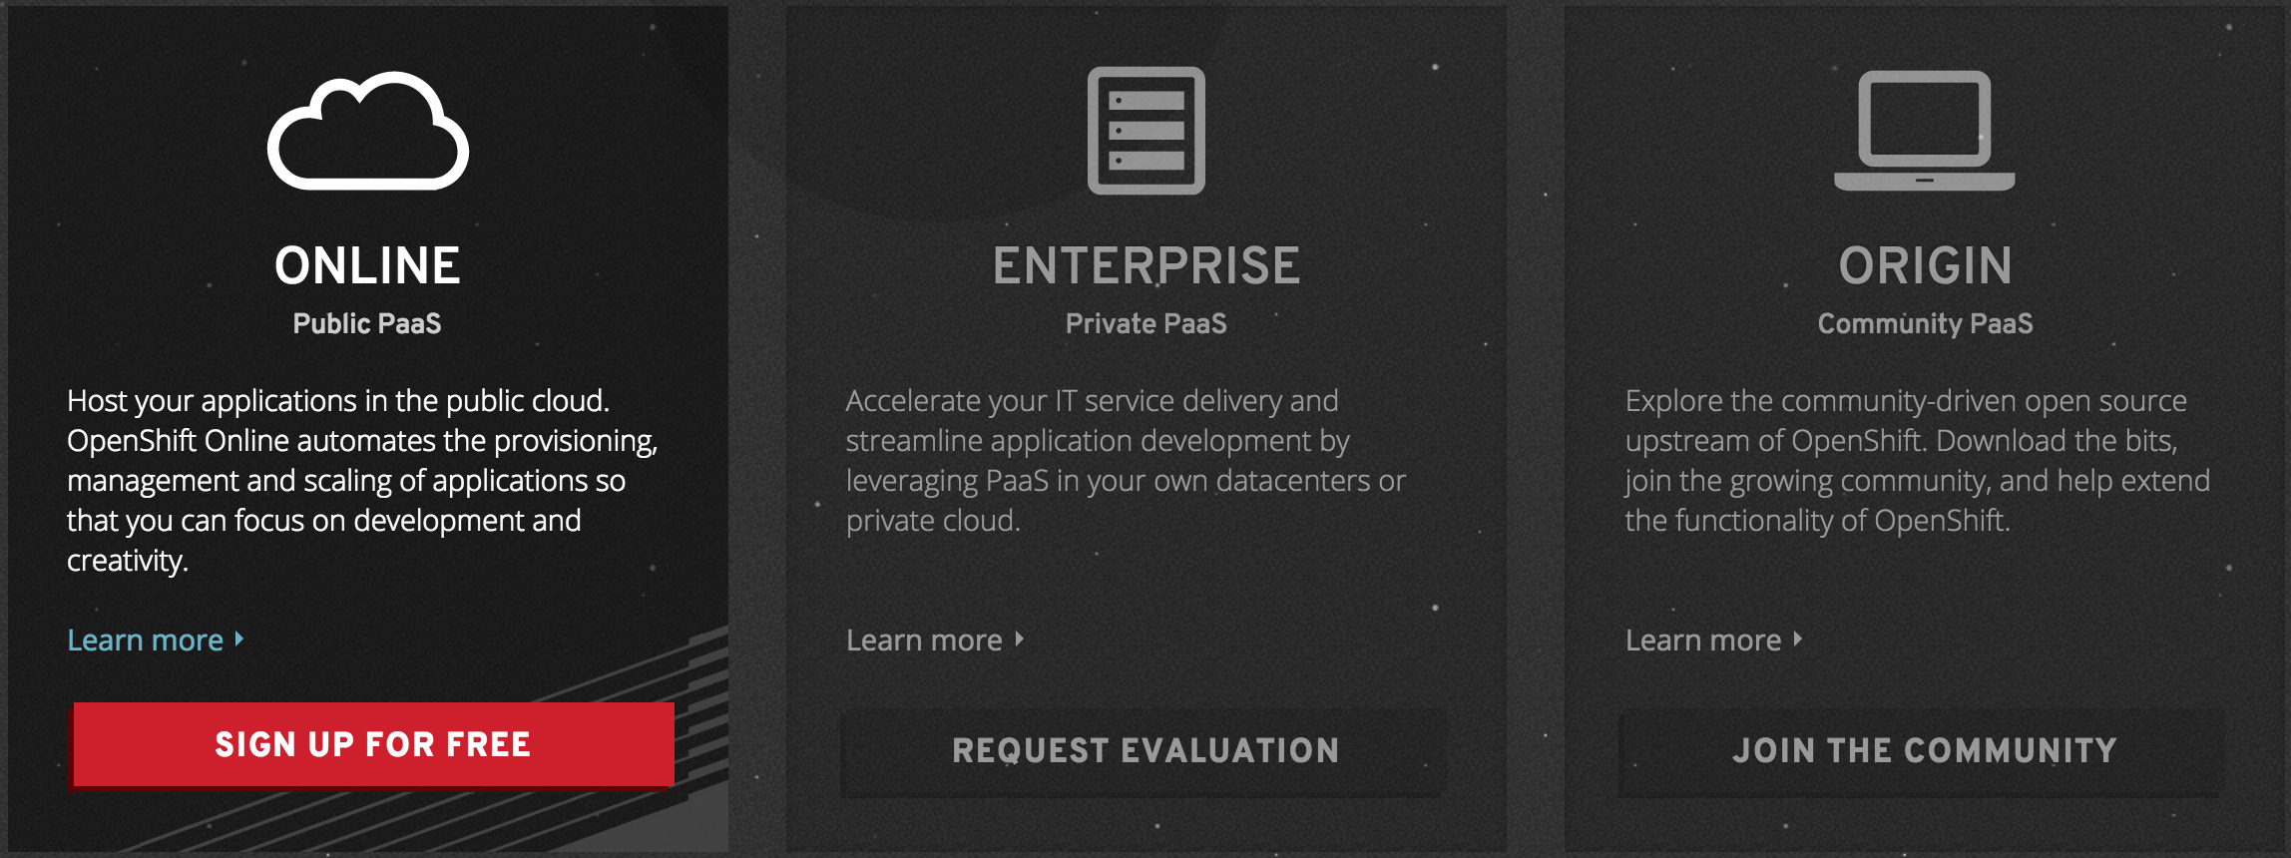
Platforms
PaaS

Slide 31
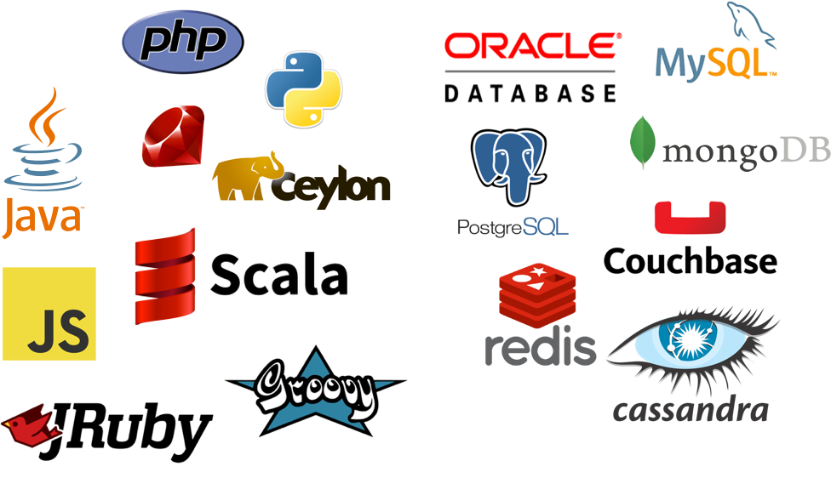

Slide 32



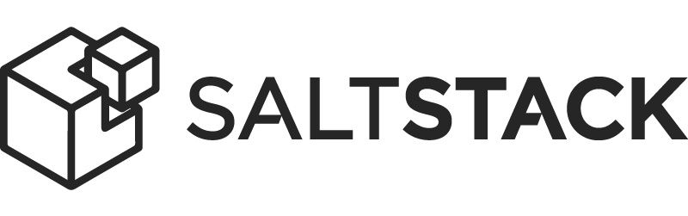


















Technologies and tools

Slide 33
Moving forward…

Slide 34
The effect on development teams
What changes to implement?
What scope?
Timing?
Who?
Expectations?
Tradeoffs?

Slide 35
Some guidance needed?
Prioritize devops
Evaluate needs according to the maturity matrix
Determine tools, tech, etc
Microservices – proceed with care!

Slide 36
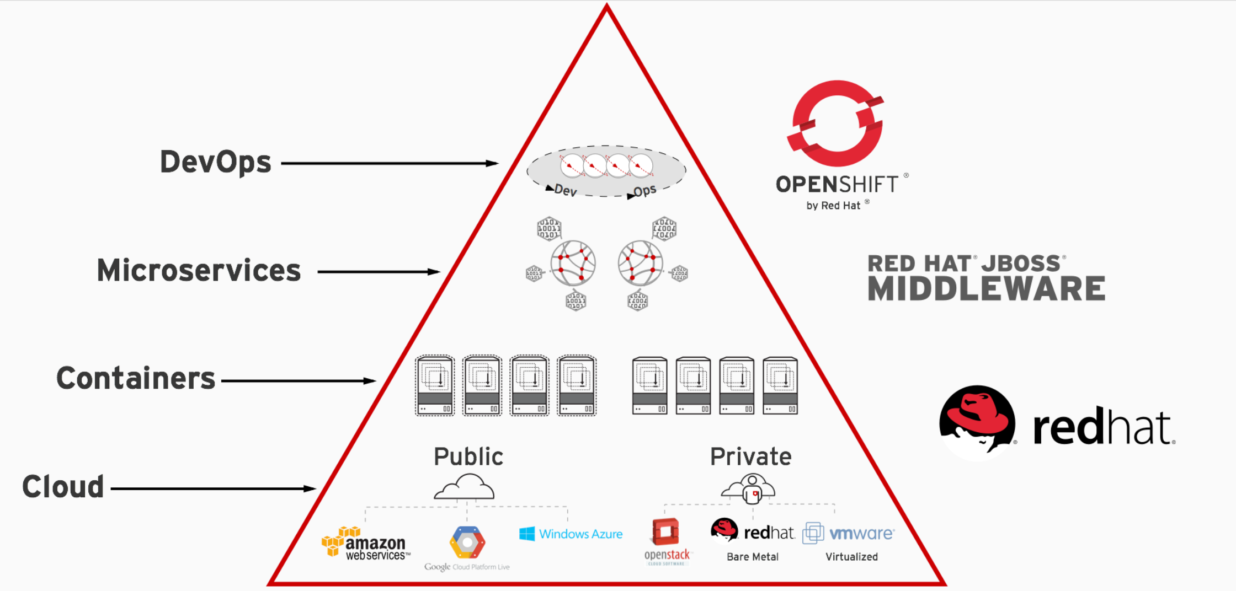
Bringing it all together

Slide 37

thank you

